Slide 1
Batch_Normalization

Slide 2
Batch
Normalization
Batch_Normalization

Slide 3
Batch_norm
Why use batch_norm?
Internal covariate shift

Slide 4
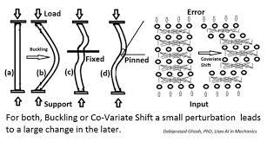
Batch_norm
Internal covariate shift
Solve Gradient vanishing
출처 : http://blog.naver.com/PostView.nhn?blogId=laonple&logNo=220808903260

Slide 5
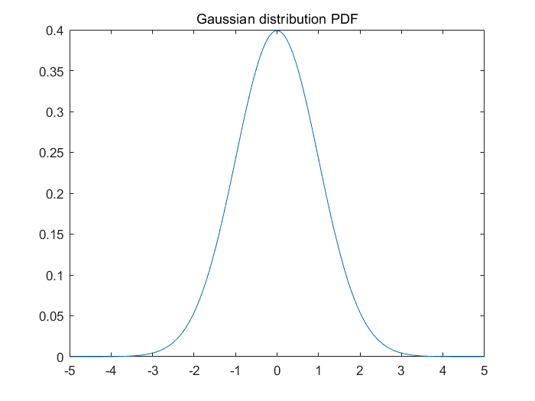
Batch_norm
All Samples follow a Gaussian distribution
Mean = 0 , Covariance =1

Slide 6
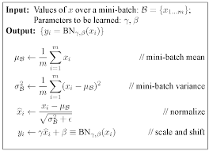
Batch_norm
Batch Normalization : Accelerating Deep Network Training by Reducing Internal Covariate Shift

Slide 7



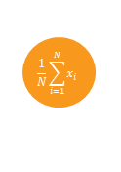
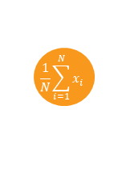


Batch_norm
How to opimize gamma, beta
Chain Rule
x
-
*
*
+
$$\frac{1}{N}\sum_{i=1}^{N}{x_{i}}$$
$$x^{2}$$
$$\frac{1}{N}\sum_{i=1}^{N}{x_{i}}$$
$$\sqrt{x+∈}$$
$$\frac{1}{x}$$
$$γ$$
$$β$$
참고 : https://kratzert.github.io/2016/02/12/understanding-the-
gradient-flow-through-the-batch-normalization-layer.html

Slide 8
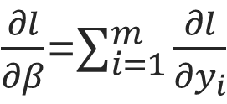
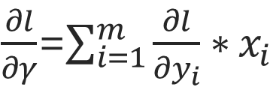
Batch_norm
$\frac{∂l}{∂γ}$=$\sum_{i=1}^{m}{\frac{∂l}{∂y_{i}}∗x_{i}}$
$\frac{∂l}{∂β}$=$\sum_{i=1}^{m}{\frac{∂l}{∂y_{i}}}$
Batch Normalization : Accelerating Deep Network Training by Reducing Internal Covariate Shift

Slide 9
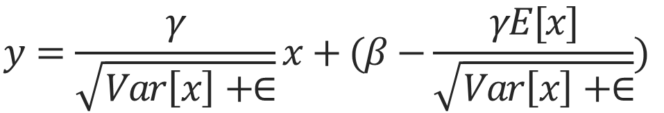


Sample Batch
Batch_norm
$$E\left[x\right]=E_{B}[μ_{B}]$$
$Var\left[x\right]=E_{B}\left[σ_{B}^{2}\right]∗\frac{m}{m−1}$
$$y=\frac{γ}{\sqrt{Var\left[x\right]+∈}}x+(β−\frac{γE[x]}{\sqrt{Var\left[x\right]+∈}})$$
Batch Normalization : Accelerating Deep Network Training by Reducing Internal Covariate Shift

Slide 10
Advantages
Batch_norm
1. Gradient Vanishing X(internal covariate shift)
2. Learning Rate Upscale
3. You don`t have to use Dropout
Batch Normalization : Accelerating Deep Network Training by Reducing Internal Covariate Shift

Slide 11
Discussion
Batch_norm
Use ReLU, Batch Norm

Slide 12
Discussion
Batch_norm

Slide 13
감사합니다
THANK YOU

